Slide 1
AUTOMATIC GARBAGE CLASSIFICATION USING DEEP LEARNING
PRESENTED BY GROUP 13 : Muhammed A V -26
Muhammed K K - 27
Muhammed Waseem -30
Swalih N C -44
GUIDED BY: FAFLI KAREEM A P
ASSISTANT PROFESSOR
DEPARTMENT OF CSE COLLEGE OF ENGINEERING VADAKARA

Slide 2
OUTLINE
Introduction
Existing System
Proposed System
Hardware Design
Methodology
Activation Function Modification
Results and Analysis
Conclusion
References

Slide 3
INTRODUCTION
Smart garbage with multi-features using machine learning tools
Functioned by Fully automated iot/sensor system
Eco friendly and customer friendly working model

Slide 4
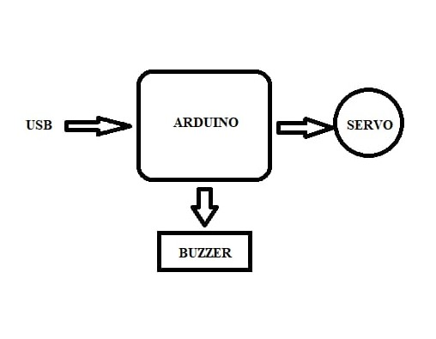
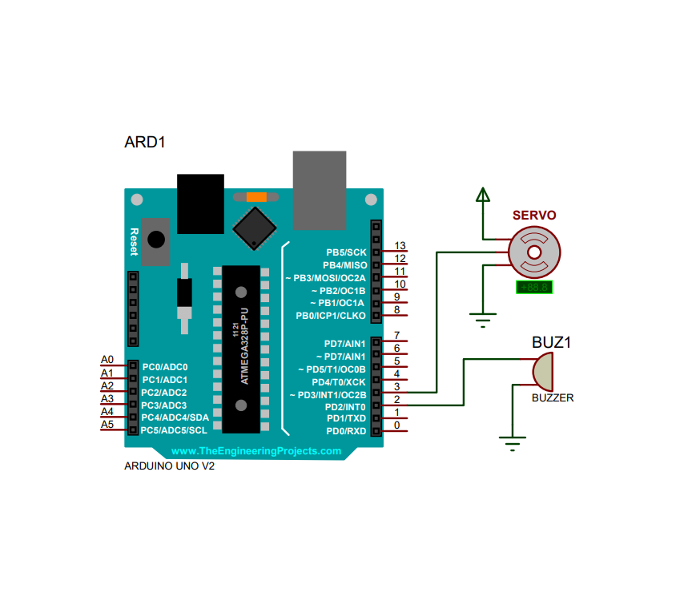
Circuit diagram

Slide 5
PROPOSED SYSTEM
The overall system of the garbage bin is designed, including the hardware structure
Including the multi feature fusion, the feature reuse of residual unit, and optimization of activation function.
Arduino is selected as the development board of the system

Slide 6
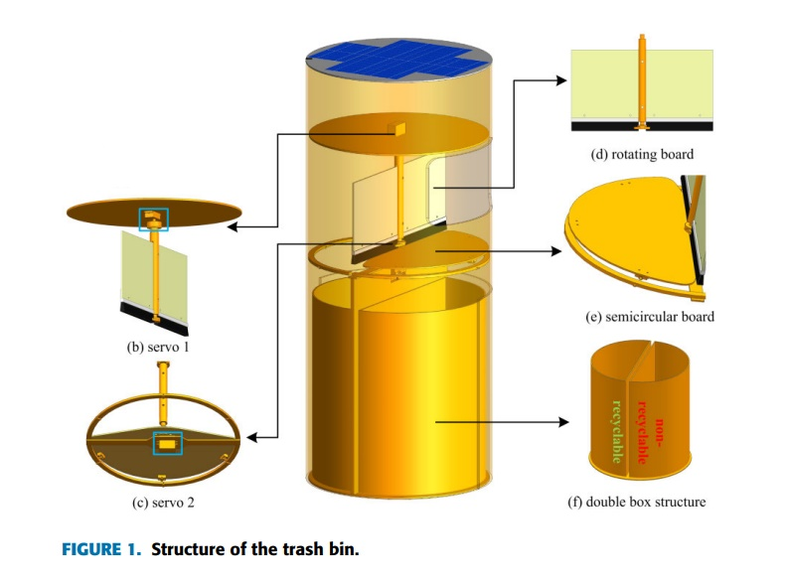

Slide 7
Servo: The servo module is ds3218. The torque is 20 kg cm. The mass is only 60 g. And the working voltage is 5.0 ∼ 6.5 V
Rotating board: it is connected with servo 1, as shown in Fig. 1 (b). It is fixed on the central column..

Slide 8
Semicircle board: it is connected with servo 2, as shown in Fig. 1 (c). When rotating, the garbage which is identified as non-recyclable would fall into the non-recyclable box.
Double box: located at the lower part of the garbage bin, it is divided into recyclable and non-recyclable boxes, as shown in Fig. 1 (f).

Slide 9
SOFTWARE MODULE
Dataset of Recyclable Waste
Dataset of Non-Recyclable Waste
Resnet Algorithm

Slide 10
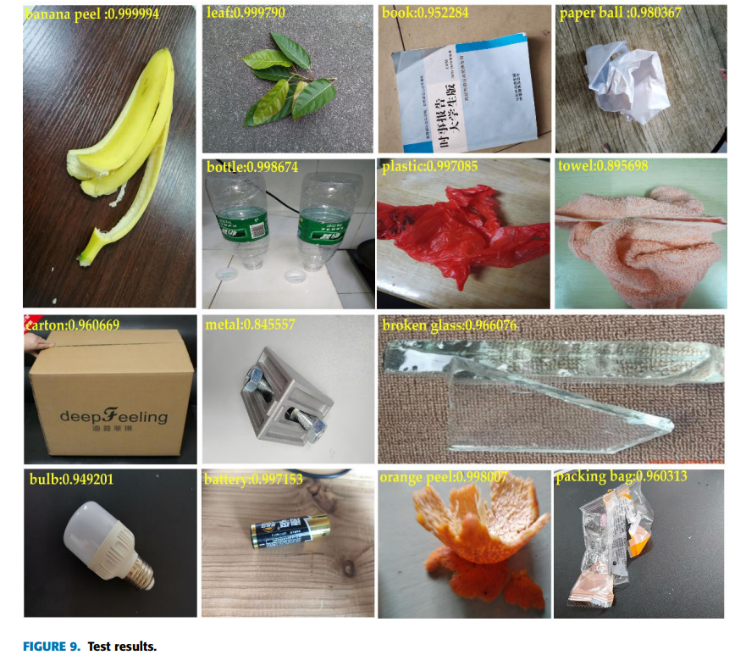

Slide 11
REFERENCES
P. Kellow, R. J. P. C. Joel, D. Ousmane, D. A. Kumar, D.-A. C. V. Hugo, and K. A. Sergei, ‘‘A smart waste management solution geared towards citizens,’’ Sensors, vol. 20, no. 8, pp. 1–15, Apr. 2020, doi: 10. 3390/s20082380
G. Zhong, W. Jiao, W. Gao, and K. Huang, ‘‘Automatic design of deep networks with neural blocks,’’ Cognit. Comput., vol. 12, no. 1, pp. 1–12, Jan. 2020, doi: 10.1007/s12559-019-09677-5..

Slide 12
REFERENCES
D. Porshnov, V. Ozols, and M. Klavins, ‘‘Thermogravimetric analysis as express tool for quality assessment of refuse derived fuels used for pyrogasification,’’ Environ. Technol., vol. 41, no. 1, pp. 35–39, Mar. 2020.
W. Pereira, S. Parulekar, S. Phaltankar, and V. Kamble, ‘‘Smart bin (waste segregation and optimisation),’’ in Proc. Amity Int. Conf. Artif. Intell. (AICAI), Dubai, United Arab Emirates, Feb. 2019, pp. 274–279.

Slide 13
THANK YOU

